Slide 1
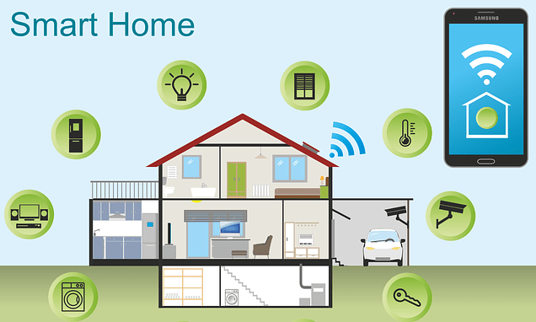
Team Noobcoder
Muhammad Amirul Hakimi Bin Zaprunnizam Muhammad Iqbal bin Mohd Fauzi Muhammad Amjad Bin Abdul Malik Patrick Stephen Muhammad Farid Izwan Bin Mohamad Shabri

Slide 2

WHAT IS A SMART HOME?
Smart home refers to a convenient home setup where appliances and devices can be automatically controlled remotely from anywhere with an internet connection using a mobile or other networked device. Devices in a smart home are interconnected through the internet, allowing the user to control functions such as security access to the home, temperature, lighting, and a home theater remotely[1].

Slide 3
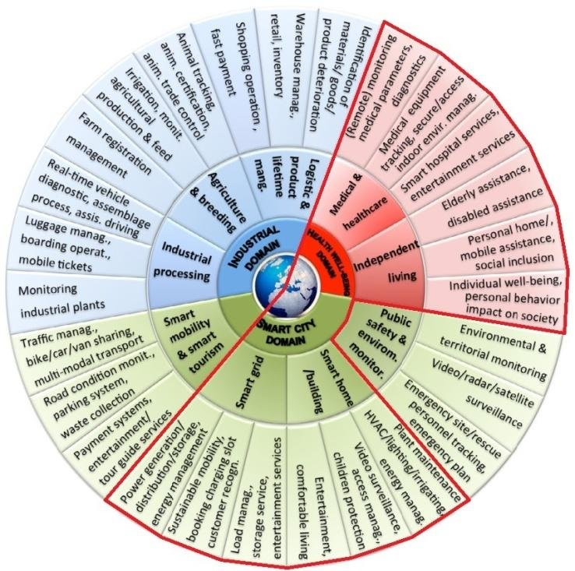
APPLICATION DOMAIN

Slide 4
APPLICATION DOMAIN
Domain of building automation system is more complex and depending on type of buildings.[3] Different systems can be applied on different buildings :
Lighting system
Solar Radiation Protection System
Sun blinds
Air-conditioning system
Heating System
Sanitary facilities
Lift facilities
Telecommunication system
Safety system

Slide 5
Main elements of Smart Home[3]
Energy = Smart homes should help us save money by being energy efficient. They should learn the usage of energy pattern and anticipate our needs.
Security = Smart homes should monitor things 24/7, so we don't have to. They should recognize any insecurities that happen and notify us, so that we can review it any time.
Convenience = Smart homes should ease our access on the things we want to control. Save more time and enjoyable.
Atmosphere = Smart homes should provide a good environment and recognize what the users like or not.
Entertainment = Smart homes should be entertaining for user to have leisure time at home.

Slide 6

HOME AUTOMATION SYSTEM[2]
made up of three elements or so-called components:
a hub
a connected application
a smart device

Slide 7
A SMART HUB
The hub is the command center of the smart home ecosystem. It’s the piece that connects individual devices and helps them talk to one another. Some systems have hubs that work only with devices from the same manufacturer, while others—like the Amazon Echo—work with myriad pieces.

Slide 8
A CONNECTED APPLICATION
An app or a connected mobile app is what gives you the ability to control or monitor your smart devices remotely. You simply download the system’s companion app and pair it with your hub, and you’re done. While each product’s app works a bit differently, they generally provide power controls, timer access, and more.

Slide 9
A SMART DEVICE
Smart devices implement commands. Here are just a few examples of the different types of smart devices you may be able to add to a system:
Access Control and Security Gadgets: Access control and security devices include security cameras, smart locks, and motion sensors.
Appliances: Almost any appliance could become a part of your home automation system in the next few years. Smart refrigerators, washing machines, dishwashers, and ovens already exist. Smaller appliances, such as connected coffee pots and slow cookers, have been around for a while, too.
Climate Controls: Climate control services often dovetail with energy management systems. Smart thermostats are the most popular example of climate controllers.
Resource Managers: Smart energy management devices include remote sprinkler controls and energy monitoring devices. Smart switches and strips fall into this category, too.
Entertainment : includes smart TVs, wireless speakers, and film projectors.
Health Care Devices: Health care systems are a growing area in the smart home industry. Smart humidifiers and smart scales are two common examples.
Lighting Controls: Lighting controls require little fanfare. They cover dimmers, light bulbs, light strips, and switches. Many manufacturers live in the lighting space, including GE, Philips, and Belkin.

Slide 10
Our devices
Home Technology
Heating
Light
Ventilation
Windows
Door
Home Appliances
Oven
Fridge
Washing Machine
Consumer Electronic
Video and Audio devices
Communication Equipment
Telephone
Pc
Internet
Electric
Switch
Socket
Powerline

Slide 11
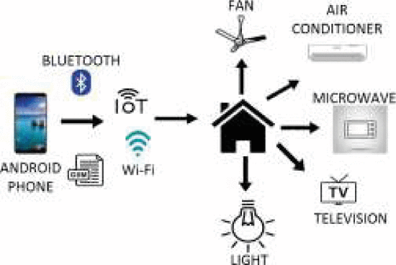
ARCHITECTURAL OVERVIEW
Home Automation System[5]

Slide 12

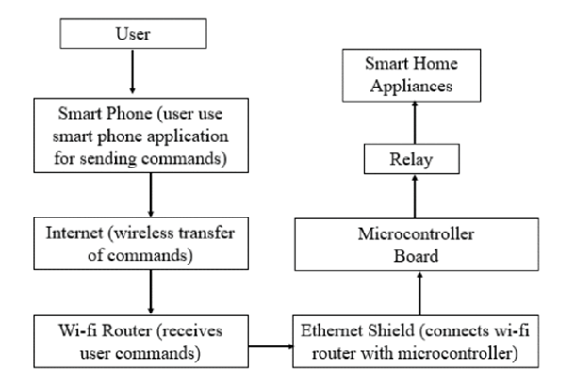


Slide 13


Technologies Used In Connected Home
RFID – Radio Frequency Identification: RFID technology using wireless RF bi-directional transmission of data between the reader and tag
IP – Internet Protocol: Wi-Fi is the fast and reliable wireless communication, with a range of around 25m.
Zigbee is a wireless protocol which operates in a mesh network and uses a device to relay a signal to other devices, strengthening and expanding the network.
Z-Wave is similar to Zigbee and this is an open source mesh network protocol.
Z-wave is roughly 6 times slower than Zigbee.
WSN – Wireless Sensor Networks: Wireless Sensor Networks (WSNs) [6]

Slide 14

Advantages of Smart Home [7]
•Managing all of your home devices from one place
•Maximizing home security
• Increased energy efficiency
• Improved appliance functionality
•Home management insights

Slide 15
Disadvantages of Smart Home [4]
Higher installation and operating cost
Voice based home smart system is low accuracy
Vulnerable to hacker attacks
Technology is not fully developed
Dependency on internet

Slide 16

References :
[1]Chen, J., 2020. Smart Home. [online] Investopedia. Available at: <https://www.investopedia.com/terms/s/smart-home.asp> [Accessed 22 November 2020].
[2]Miller, M., 2017. My Smart Home For Seniors. Que
[3]Felfernig, A., Hotz, L., Bagley, C. and Tiihonen, J., 2014. Knowledge-Based Configuration. Morgan Kaufmann.
[4] M. Hasan, P. Biswas, M. T. I. Bilash and M. A. Z. Dipto, "Smart Home Systems: Overview and Comparative Analysis," 2018 Fourth International Conference on Research in Computational Intelligence and Communication Networks (ICRCICN), Kolkata, India, 2018, pp. 264-268, doi: 10.1109/ICRCICN.2018.8718722.
[5]R. Sivapriyan, K. M. Rao and M. Harijyothi, "Literature Review of IoT based Home Automation System," 2020 Fourth International Conference on Inventive Systems and Control (ICISC), Coimbatore, India, 2020, pp. 101- 105, doi: 10.1109/ICISC47916.2020.9171149.
[6]Molly Edmonds “How Smart Homes Work - Setting Up a Smart Home” http://home.howstuffworks.com/home-improvement/energy-efficiency/smart-home1.htm
[7]User, B., 2020. 7 Greatest Advantages Of Smart-Home Automation. [online] Bluespeedav.com. Available at: <https://www.bluespeedav.com/blog/item/7-greatest-advantages-of-smart-home-automation> [Accessed 14 June 2016].

Slide 17
THANK YOU

